Slide 1
Benvenuti al POLI
16.09.2024 | Gianni Ferretti

Slide 2
Agricultural Engineering

Slide 3

Study Programme in Agricultural Engineering
Offered within the School of Industrial and Information Engineering.
Based at Cremona Campus.
To obtain the Master’s degree, it is necessary to earn 120 ECTS credits:
35 to 40 ECTS from alignment courses
60 to 65 ECTS from mandatory courses
5 to 10 ECTS from elective courses
a final thesis corresponding to 5 ECTS

Slide 4
Study Programme in Agricultural Engineering
The Admission Commission for the Master's degree assigns each admitted student a track on the basis of the Bachelor's degree from which he/she comes:
students from a Bachelor's degree in Engineering who already have a solid background in Mechanical Engineering, but not in automatic controls, shall be assigned the track AGM;
students from a Bachelor's degree in Engineering who already have a solid background in Environmental Engineering, but not in automatic controls, will be assigned the track AGE;
students from a Bachelor's degree in Engineering who do not fall into the two previous cases, will be assigned the track AGA;
students from a Bachelor's degree other than Engineering, will be assigned the track AGI.

Slide 5
Study plan
During the year, there are two time periods when students are allowed to present and modify the study plan:
At the beginning of the first semester (September / October):
one can introduce changes (add, remove, change from “effective (E)” to “excess (S)” and vice versa) to courses of both the first and second semester
At the beginning of the second one (March):
one can make the following changes related to courses of the ongoing academic year only: 1) add and delete 2nd semester courses and 2) change from “effective (E)” to “excess (S)” and vice versa to courses of both 1st and 2nd semester

Slide 6
Evaluation of the study plans
The committee can proceed with the evaluation of the study plans only after the expiration of the deadline for their presentation/modification
Evaluation typically takes two to three weeks
If a study plan is not approvable, the committee will contact the student by email to agree on a solution. The consequent modification of the study plan will be made by the committee

Slide 7
Training beyond the MSc programme
Massive Online Open Courses (MOOCs) – www.pok.polimi.it
  POLIMI portal offers free online courses to support students in their academic and professional career. A certificate of attendance is provided if the final test is passed
Passion in action – www.polimi.it/corsi/passion-in-action
  Open participation teaching activities that POLIMI offers to its students to support the development of transversal, soft and social skills. Acquired skills will be accredited on the Diploma Supplement

Slide 8
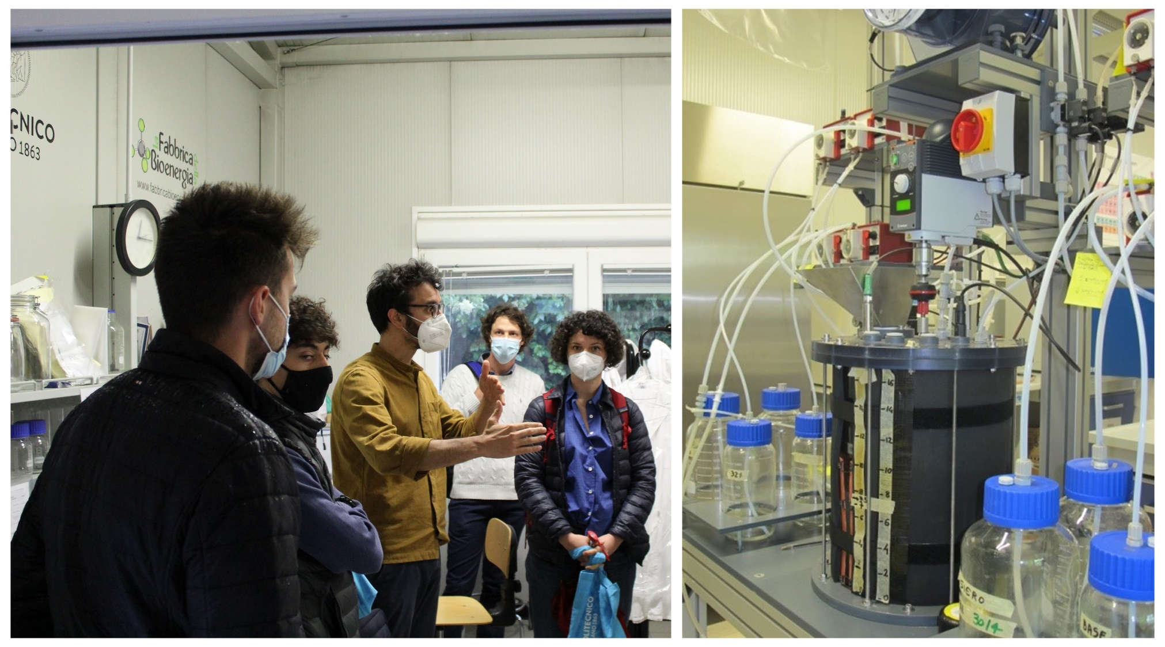
Disclosing the hidden energy of biowaste
Laboratory project work aimed at developing a small pilot for the production of biogas from biowastes, including the assembling of a prototype equipped with all the relevant components as well as its operation, monitoring and control
A multidisciplinary group of teachers guided the participants in the design and construction of:
A reactor for anaerobic digestion
A real-time monitoring system capable of
transmitting data to the cloud
A logic and modulated control system capable
of guaranteeing a proper behavior of the
chemical process
A measuring system for produced biogas flowrate

Slide 9
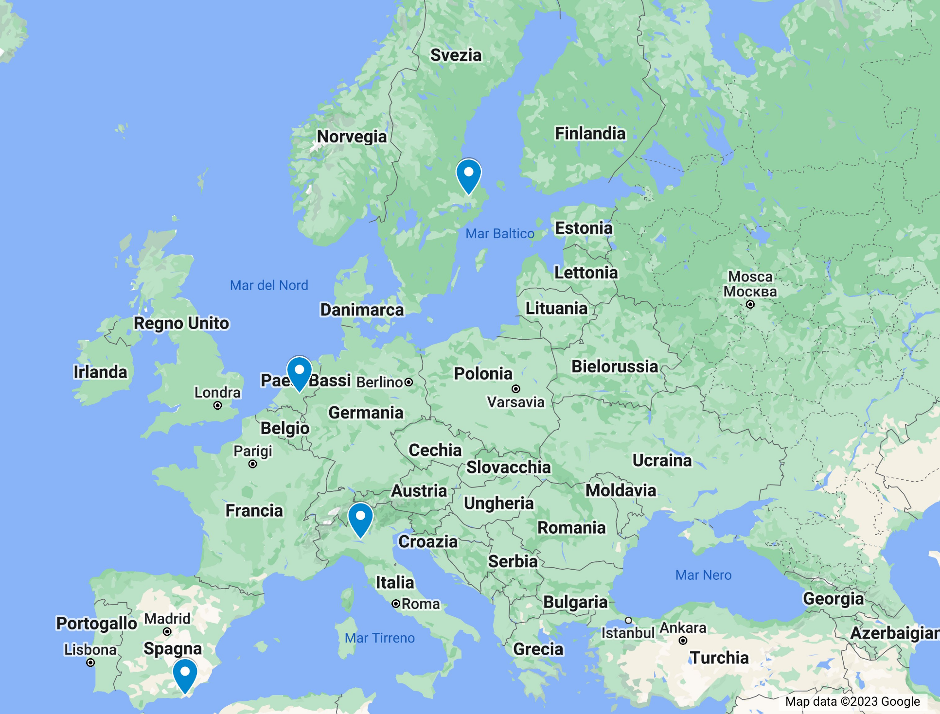
Opportunities for an experience abroad
Universidad de Almeria (Spain)
Attending courses
Working on the thesis
Wageningen University (The Netherlands)
Working on the thesis
Swedish University of Agricultural Sciences (Sweden)
Working on the thesis

Slide 10
Tutoring in Mathematical Analysis
To support students, in particular those coming from a non-engineering bachelor, a tutoring in Mathematical Analysis is organized during the first semester.
14 meetings, 1 hour and a half each, from September to December
bi-weekly meetings for the first month
weekly meeting for the other 3 months

Slide 11
Educational obligations in Italian
Starting from the academic year 2021/22, an Italian language proficiency test is compulsory for all foreign students before sitting the degree examination and completing their studies
Italian language courses are organized free of charge
The student is required to:
Register and take the preliminary level test
Attend at least 75% of the assigned course
Register and take the exit test

Slide 12
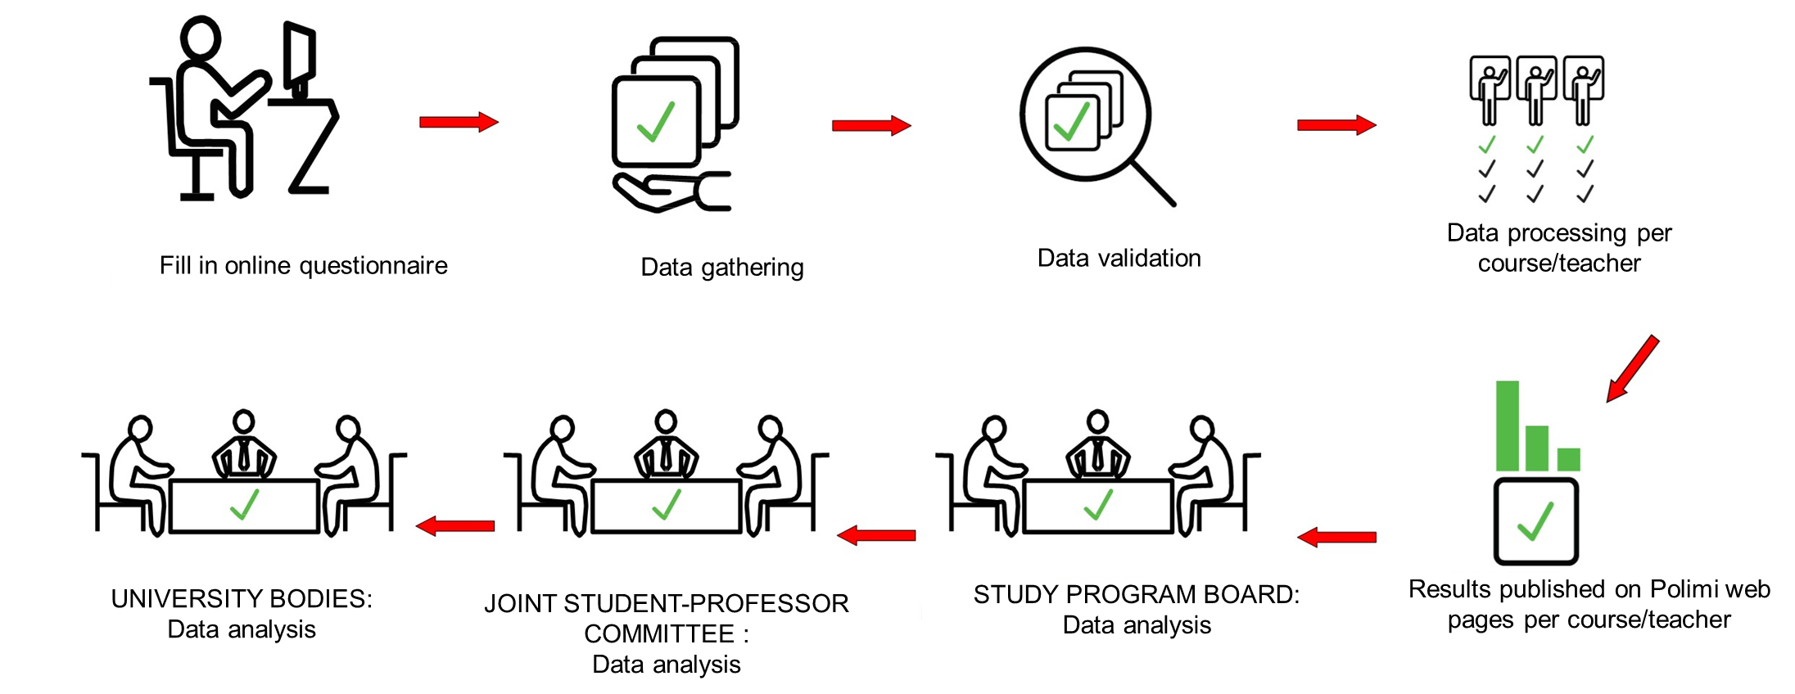
Opinions of the students on teaching
Filling in an ANONYMOUS online questionnaire for each course is MANDATORY for enrollment in exams
The questions concern:
teaching
teachers
teaching assistant activities
Infrastructures
Since your opinions are highly considered, you are invited to:
Pay particular attention to the questionnaire compilation
Give informed and consistent answers to the questions
Provide proactive and constructive comments

Slide 13
Opinions of the students on teaching
In the last year of the MSc Study Programme, we collected your opinion on:
The whole training path
  Mandatory questionnaire for enrollment in the Final Degree Exam on: Organization of teaching, specific contents, infrastructures, library, internships, international mobility, final exam
Student support services
  Anonymous and mandatory questionnaire for registration to the 1st exam of the year on: Enrollment, Study plans, exam registration, taxes, student offices, ICT services, libraries, PoliPrint, catering, communication, physical environment

Slide 14
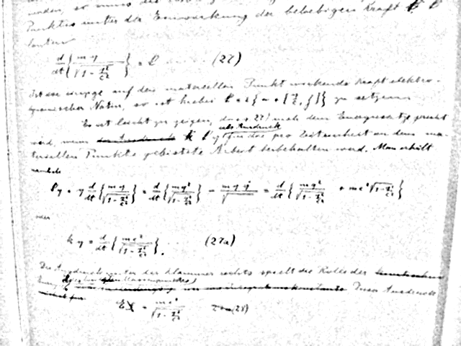

Grazie per l’attenzione
Everything should be made as simple as possible, but not simpler.
Albert Einstein

