Slide 1
Benvenuti al POLI
16.09.2024 | Gianni Ferretti

Slide 2
Music and Acoustic Engineering

Slide 3


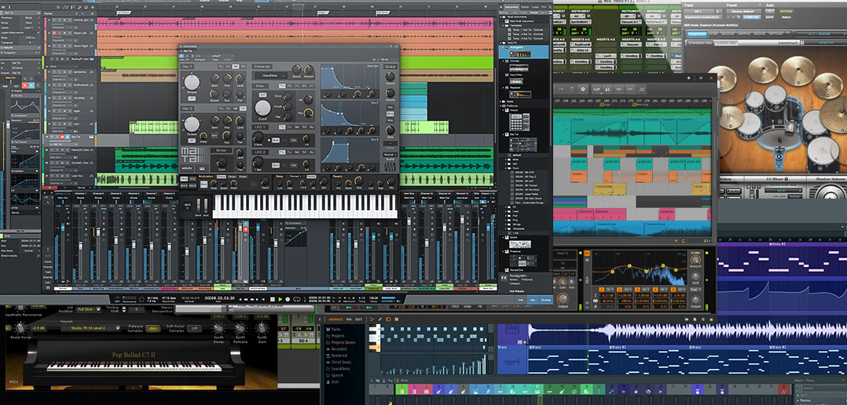
Didactic Structure of the Program
Two didactic tracks sharing the same fundamental courses:
Acoustic Engineering
(Cremona Campus)
Music Engineering
(Milano Leonardo Campus)
Most differences in the second year

Slide 4
Course Attendance
Students must be present in the classrooms.
Most MAE Courses are shared between the MI-Leonardo campus and the Cremona Campus.
Such courses are delivered in synchronous mode.
Professors/instructors will alternate their presence between the two campuses.

Slide 5
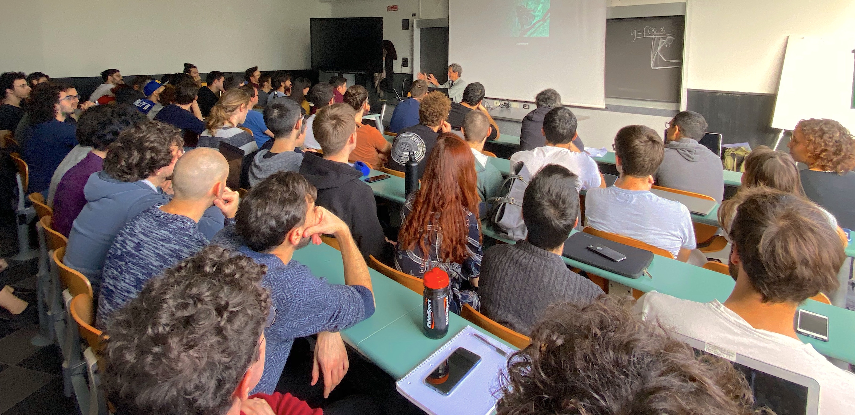
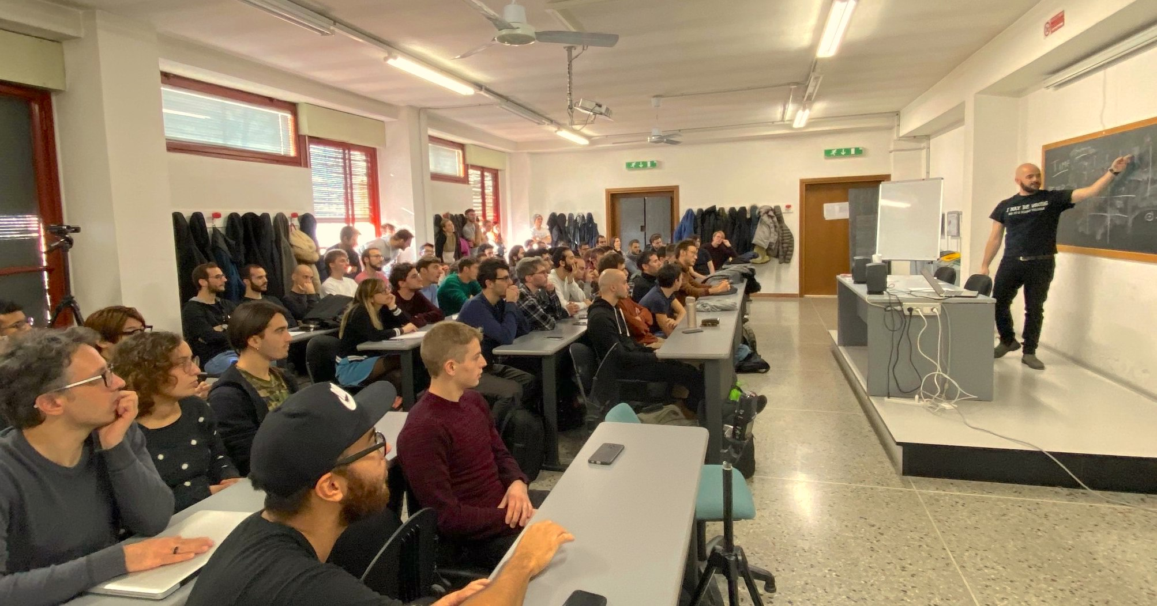
Exceptions to the In-Presence Policy
  Some professors will allow students to be connected online when the classes are offered online in their campus.
  If you have included in your study plan a course which has no classroom in your campus, you are allowed to attend online.
  If in your personal situation (e.g., health problems, work, etc.) you can attend classes online only, you are invited to send a certification to fabio.antonacci@polimi.it.

Slide 6
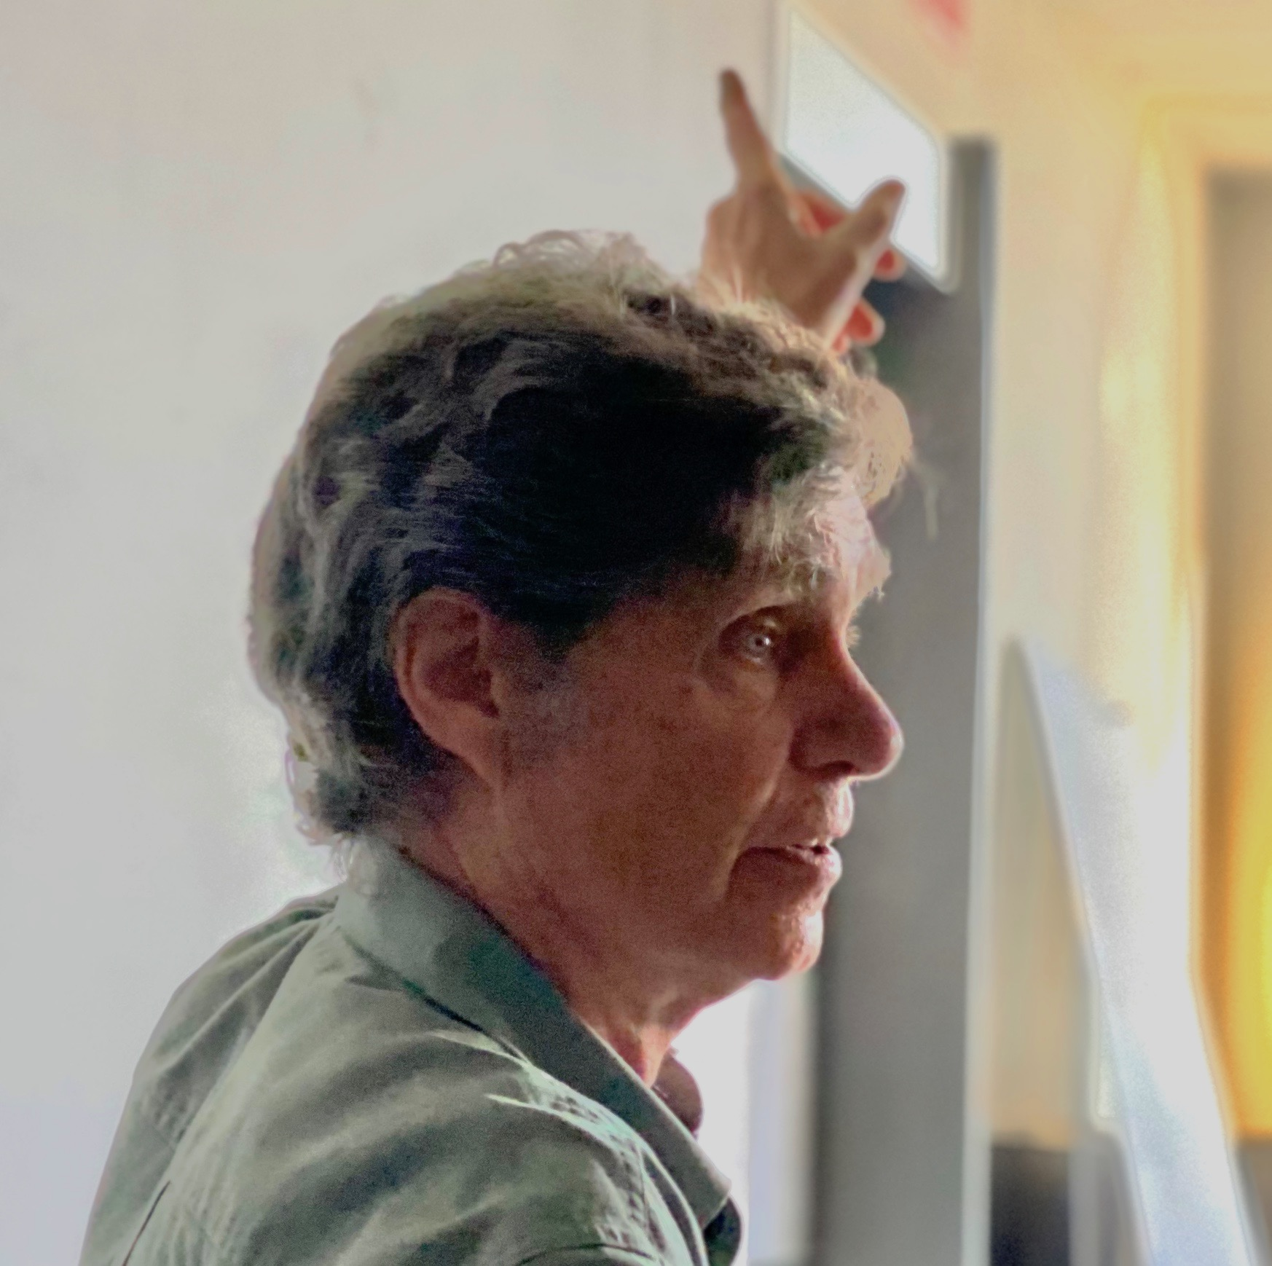
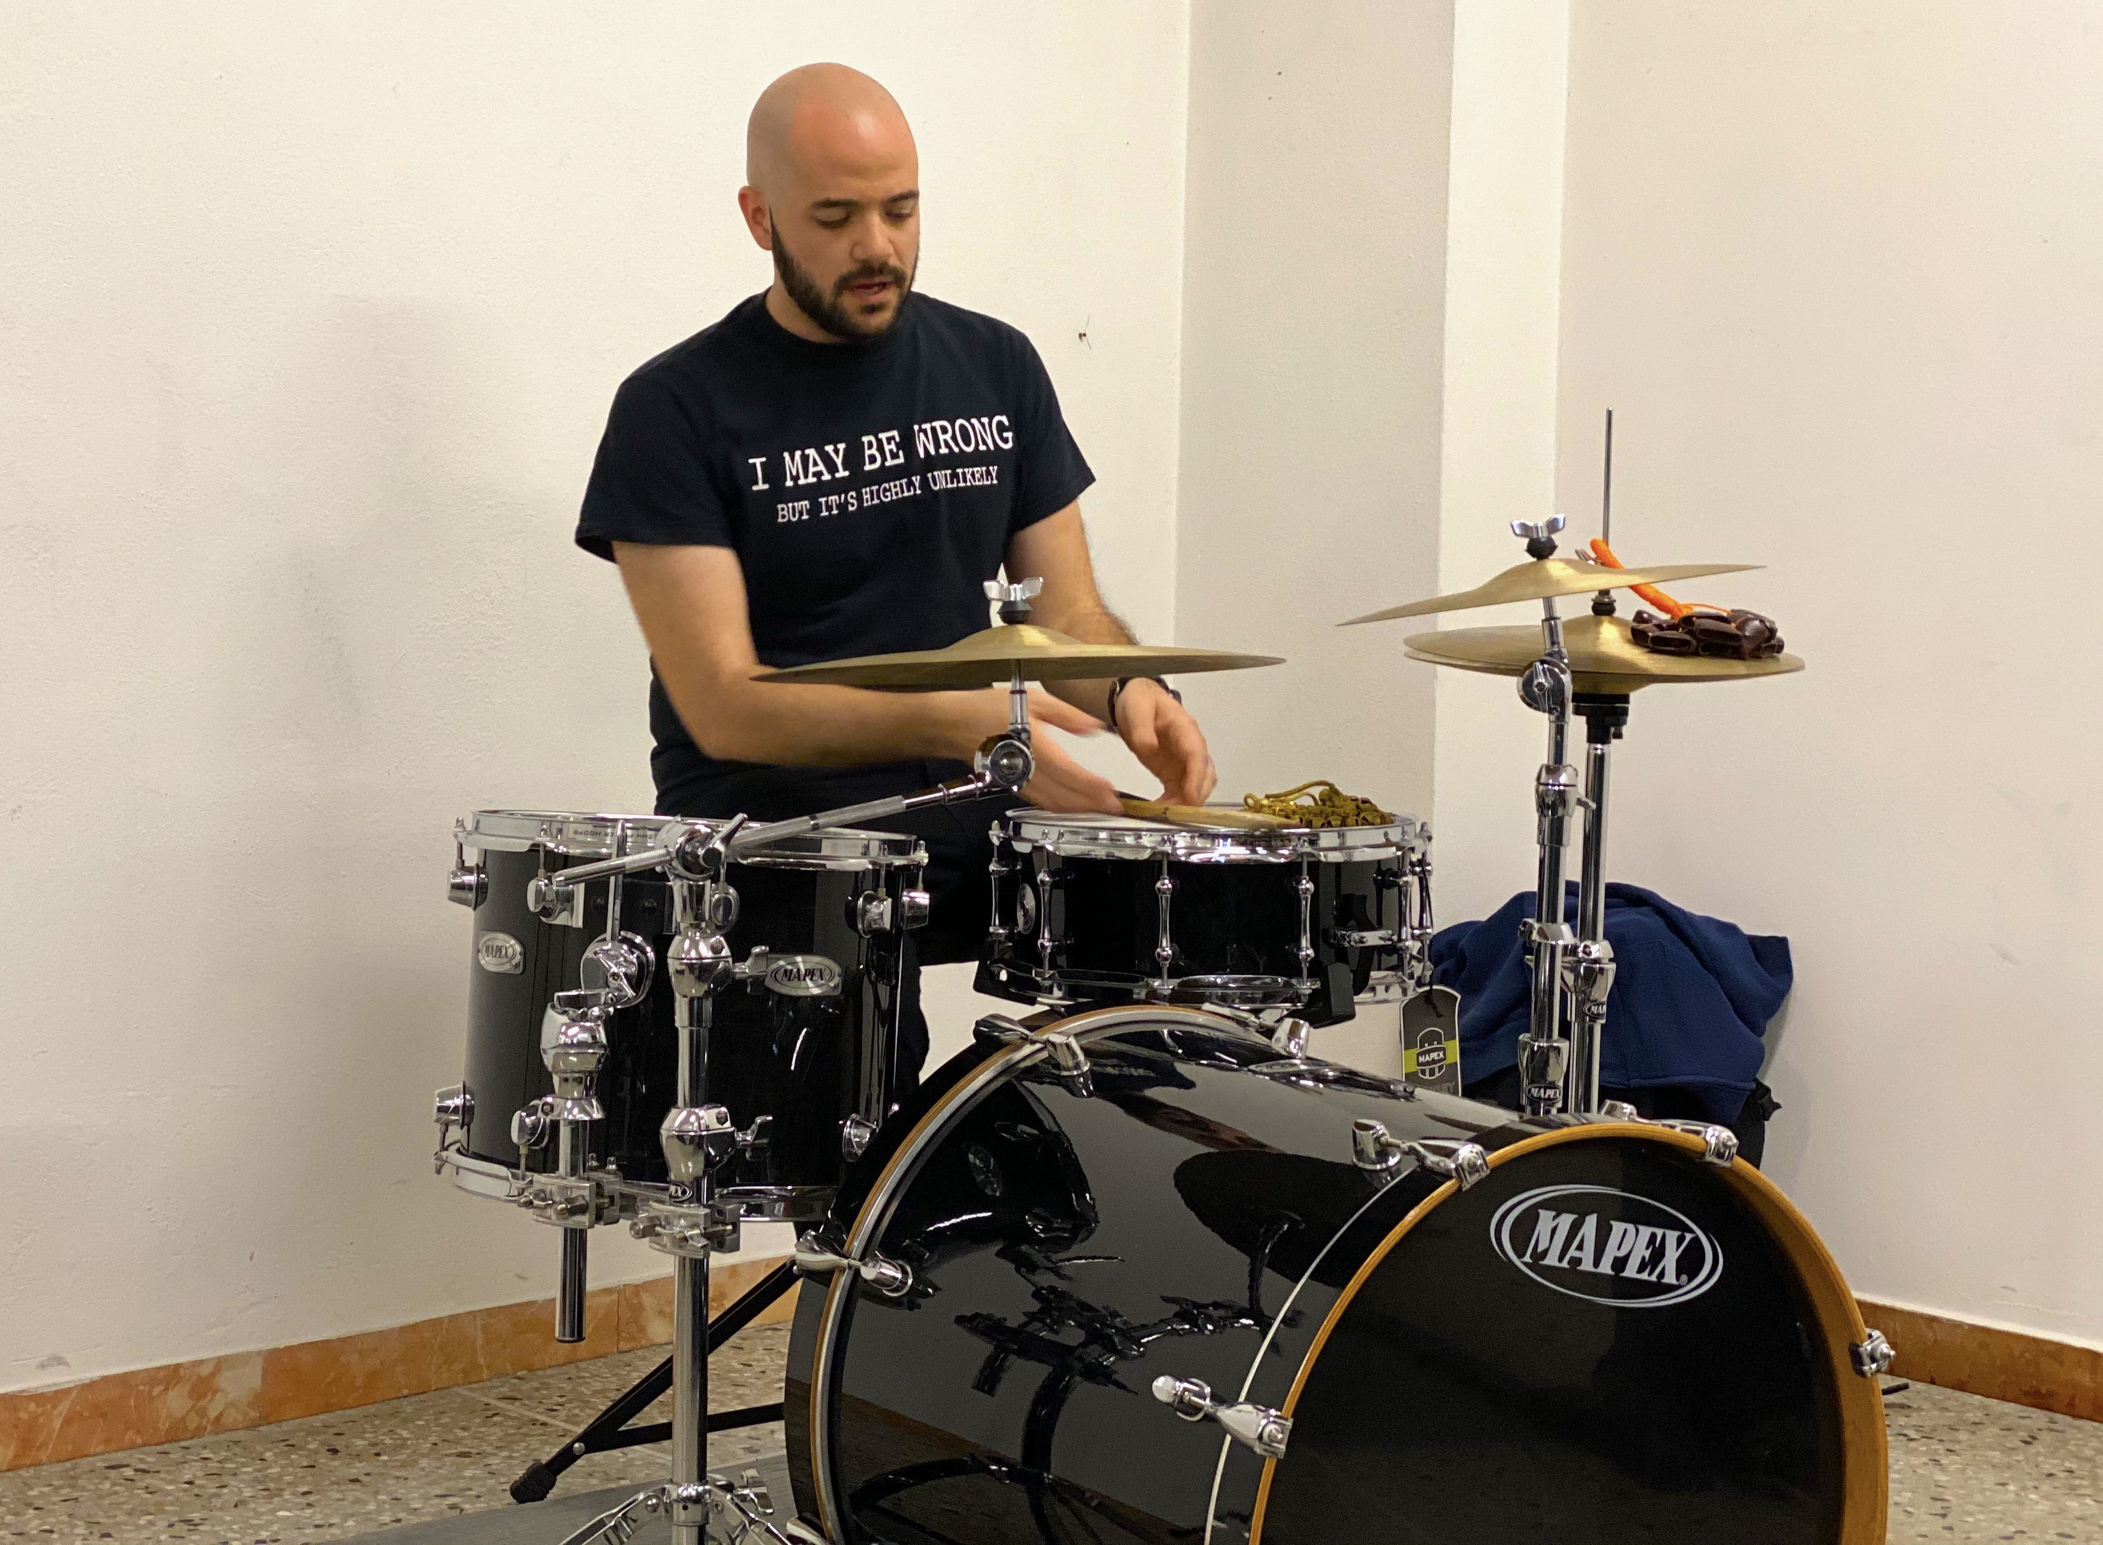
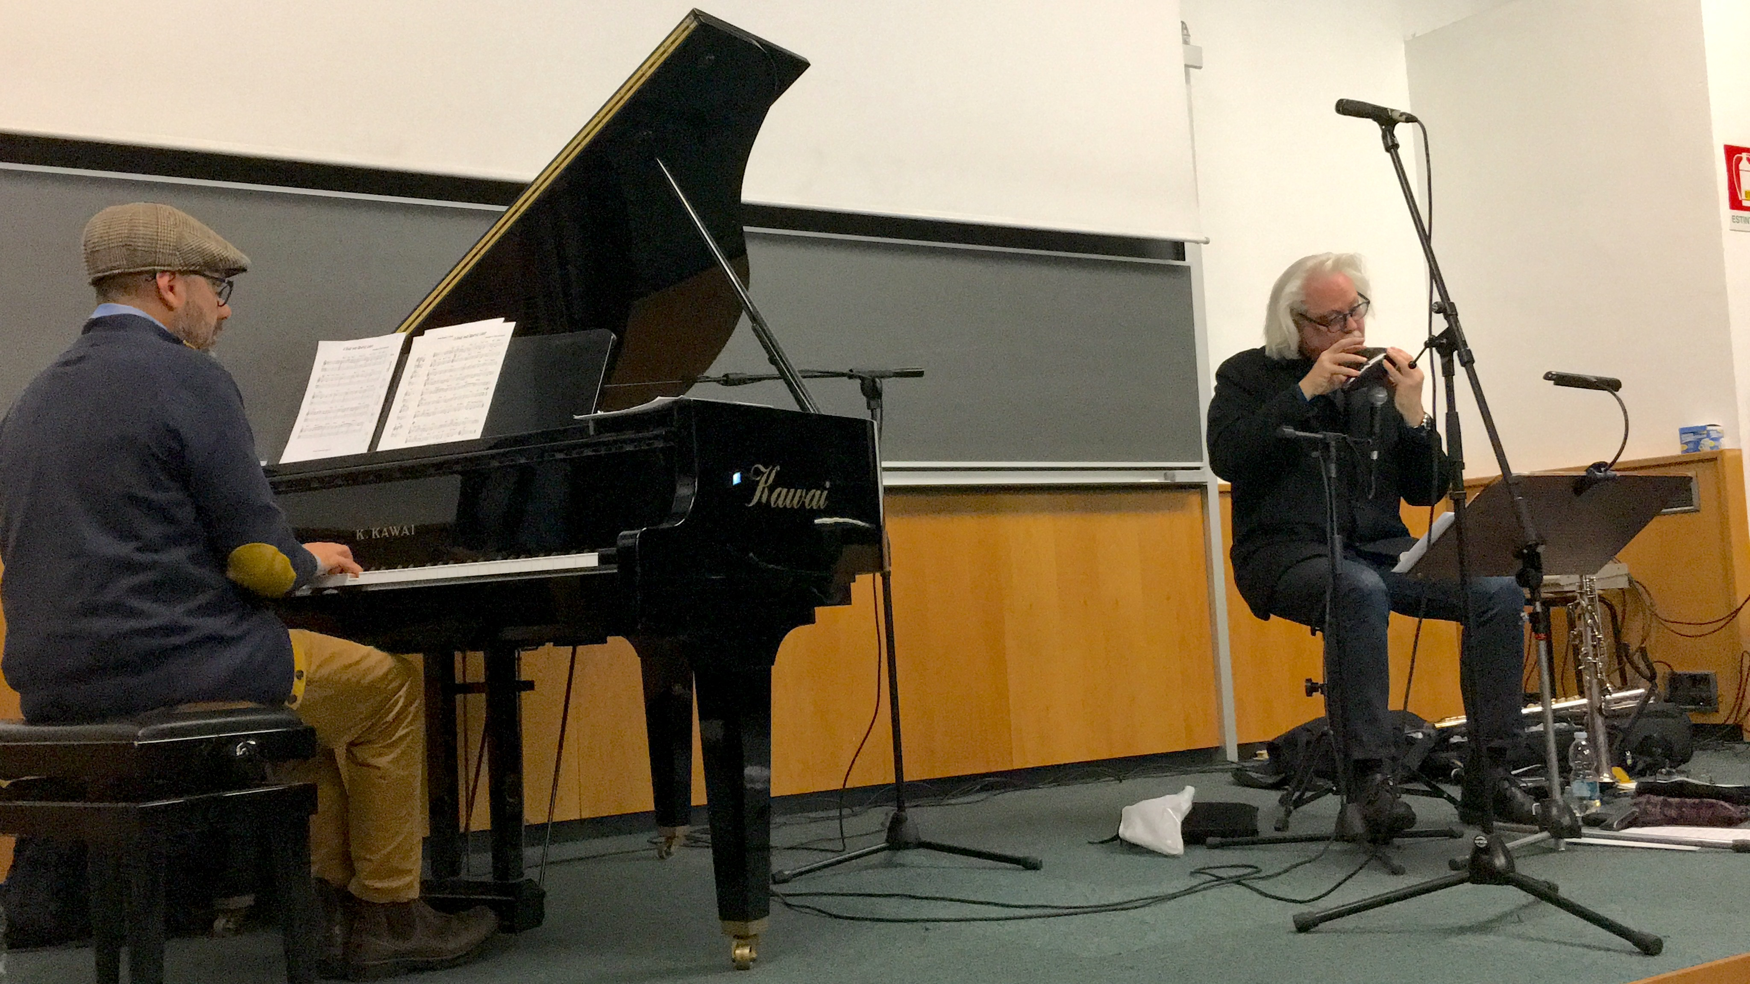
Workshops
During the lecture period, workshops related to the content of the MAE courses are often organized and taught by external guests, typically researchers or professional musicians.
Chris Chafe
Stanford Uni.
Yogev Gabay
Antonio Figura
Dave Shroeder
(NYU)

Slide 7
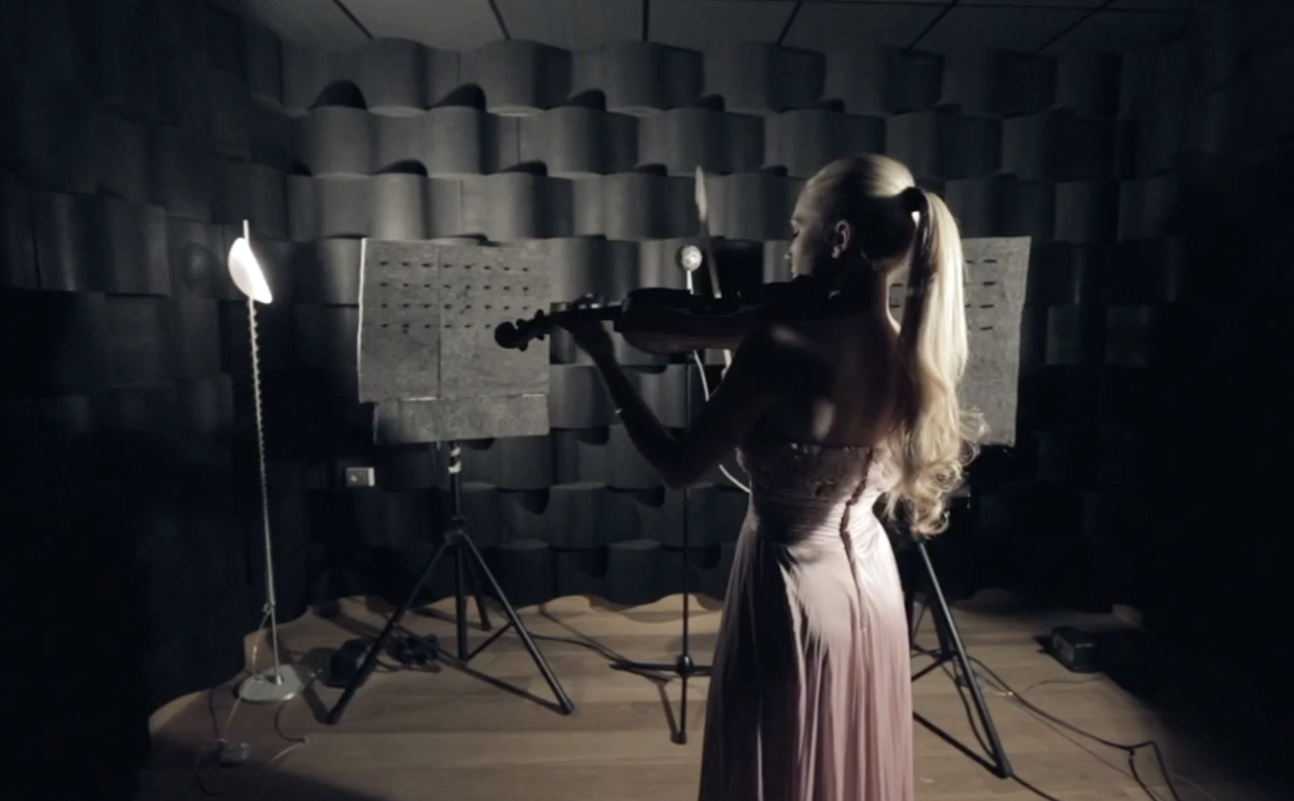
Facilities: Musical Acoustics Lab

Slide 8
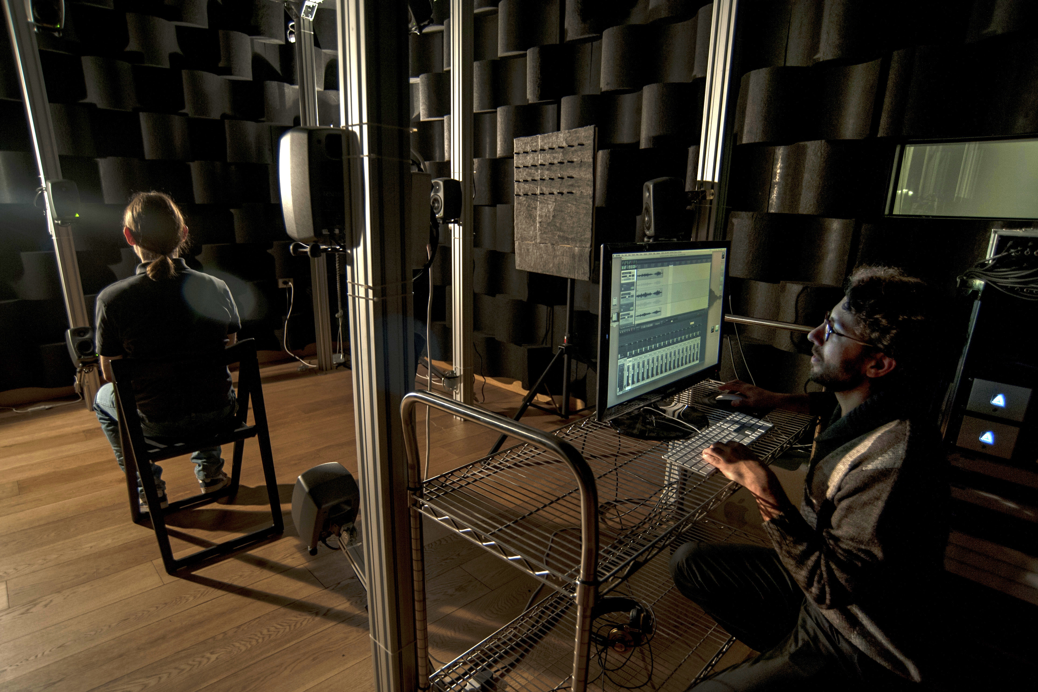
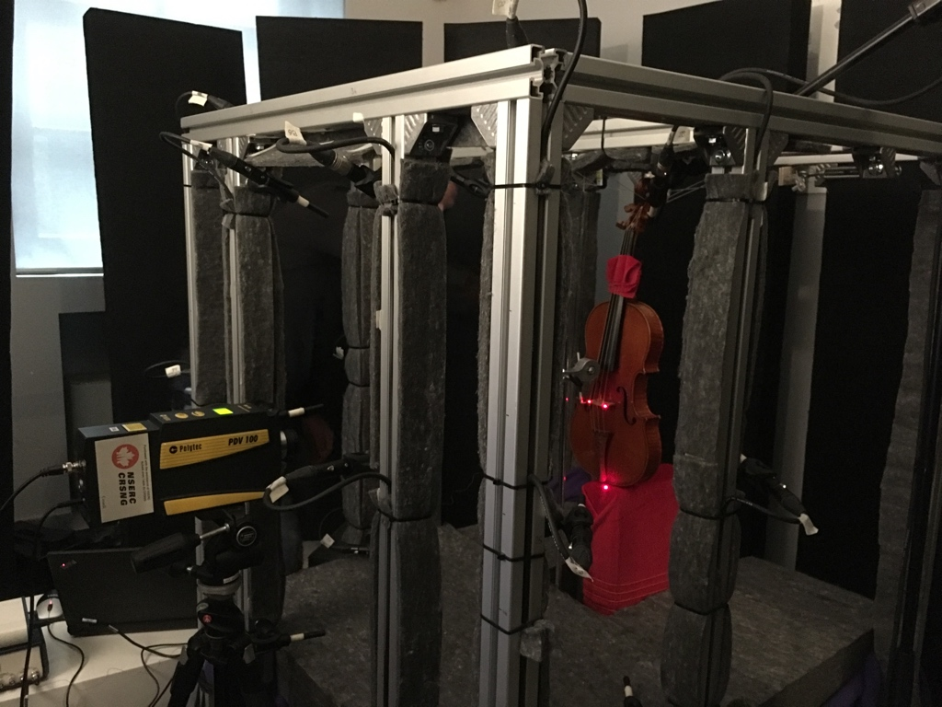
Facilities: Musical Acoustics Lab

Slide 9
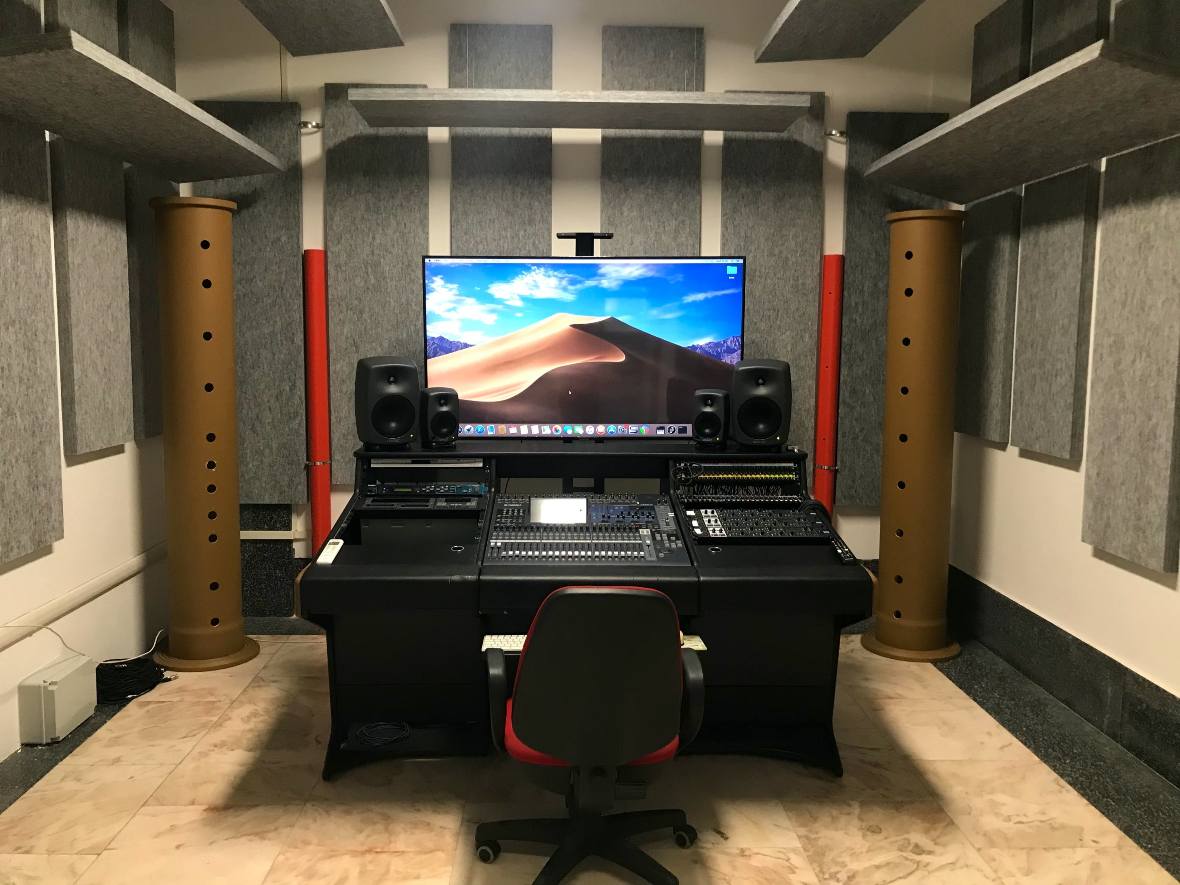
Facilities: StudioLab

Slide 10
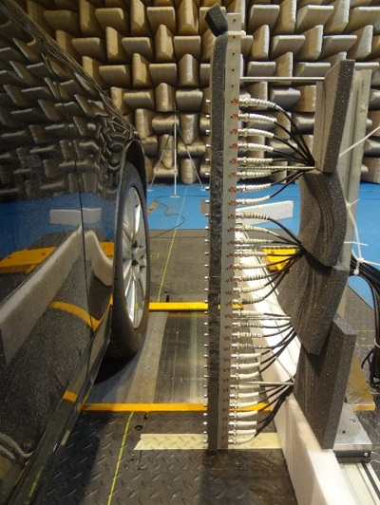
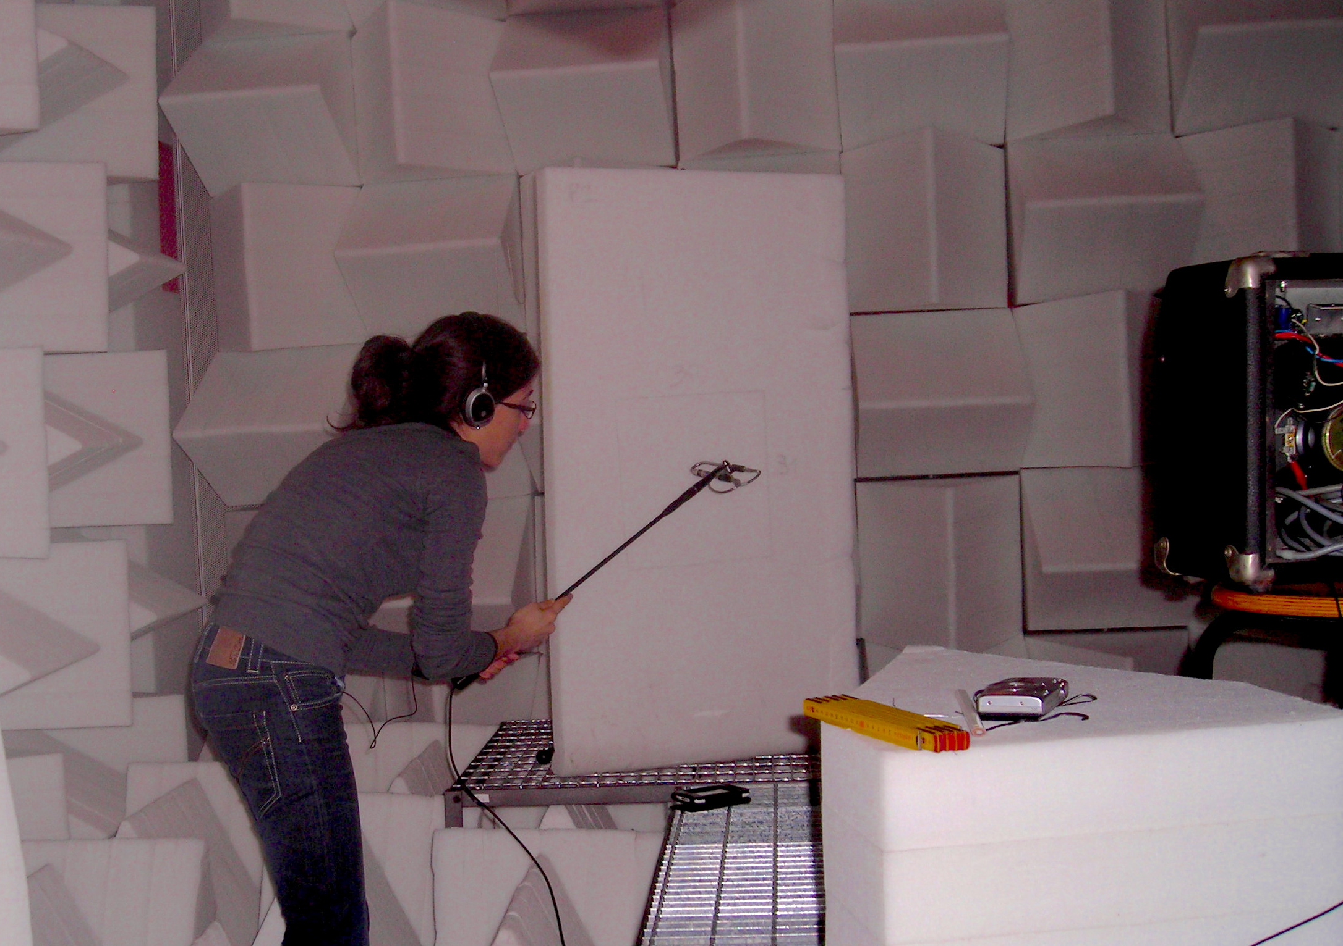
Facilities: PoliMI Sound and Vibration Lab

Slide 11
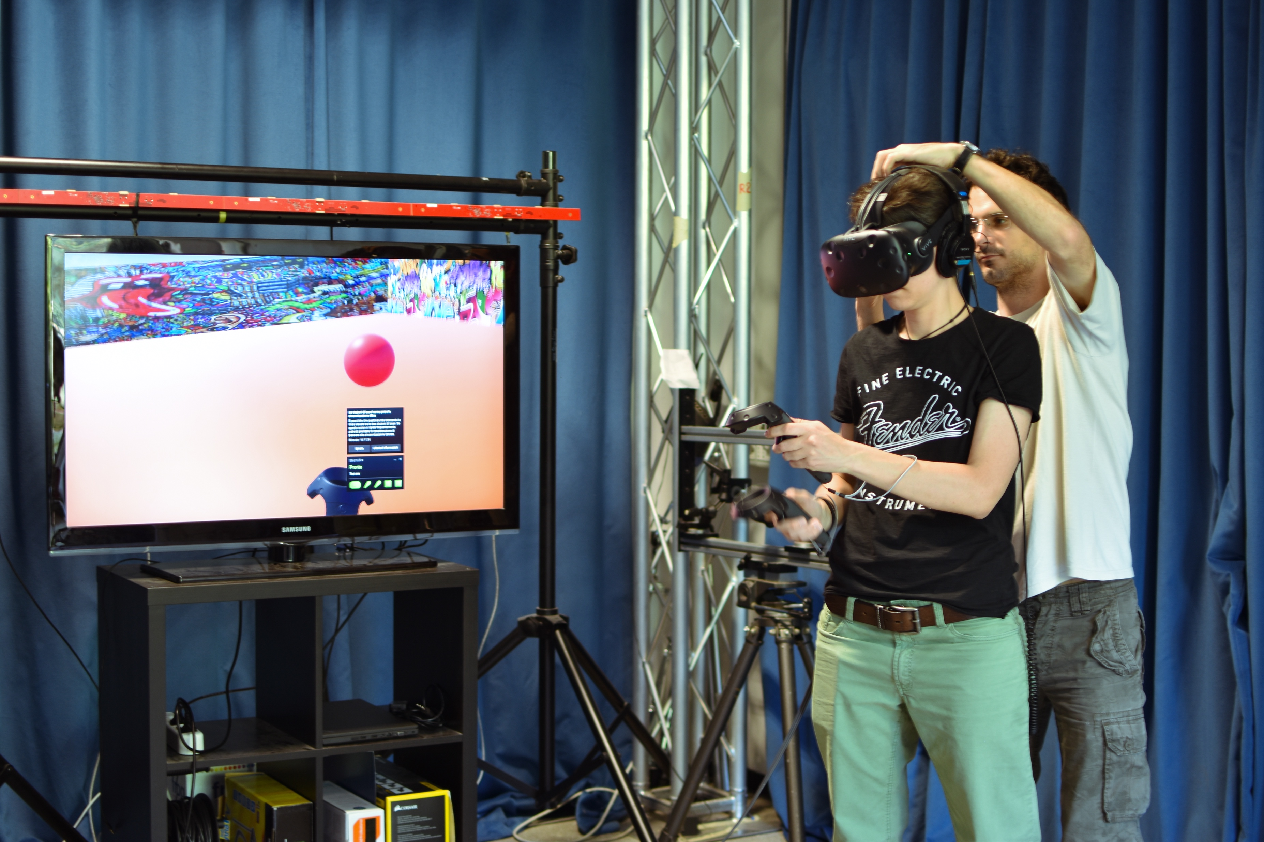
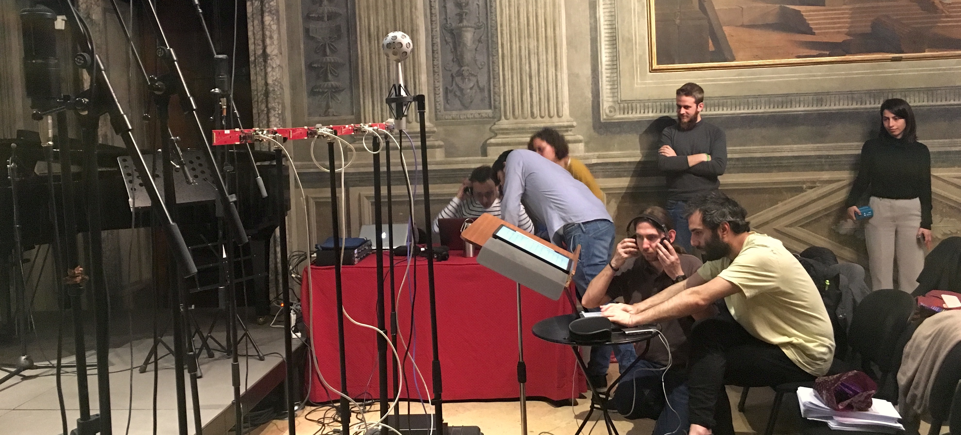
Master Thesis
Different possibilities:
Thesis at PoliMI
Thesis abroad in international research laboratories collaborating with PoliMI research groups
Thesis in italian or international companies (often in conjunction with pre- or post-graduation internships)

Slide 12
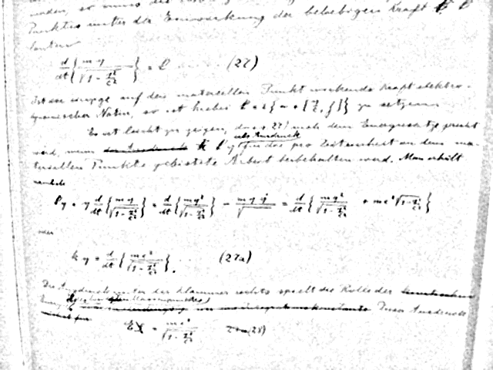

Grazie per l’attenzione
Everything should be made as simple as possible, but not simpler.
Albert Einstein

